Slide 1
Lesson 8 - Selecting Columns
Mack 2021

Slide 2
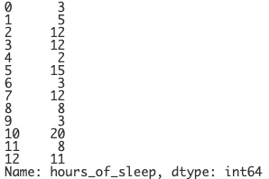
Selecting Columns
Specific columns (or series) can be selected instead of displaying the entire table.
Selecting a single column from the DataFrame will return a Series object.
print(mammals["hours_of_sleep"])
Notes:
The use of brackets can be using to denote which columns to display as well. Here, we are telling python to only display the hours of sleep column. Since it is only one column, what is displayed is a series. This may or may not be very helpful though since it’s not easy to determine which animal from our table belongs to each index.

Slide 3
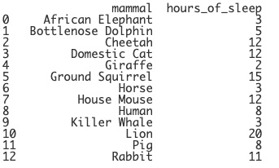
Selecting Columns
Specific columns (or series) can be selected instead of displaying the entire table.
Selecting a single column from the DataFrame will return a Series object.
print(mammals[["mammal", "hours_of_sleep"]])
Notes:
What we can do is print out both the mammal and the hours of sleep column. This returns a smaller, filtered DataFrame. Notice, that there are two brackets in this command. The syntax can get tricky, so we’ll want to always be aware and double check it.

Slide 4
Selecting Columns
sleep_data = mammals[["mammal", "hours_of_sleep"]]
print(sleep_data)
Notes:
Since the syntax is a bit tricky, if we’d like to use this filtered DataFrame more than once, we can store it in its own variable. This time, anytime we’d like to only display the mammals and hours of sleep columns, we can just print out the sleep_data variable instead of the whole mammals table.

Slide 5
Using Conditions
sleep_data = mammals[["mammal", "hours_of_sleep"]]
print(sleep_data)
Notes:
We can also filter for specific rows within specific columns. For this, we include a condition. Let’s say we wanted to display only the rows of animals who sleep less than 4 hours. First, we use the sleep_data variable so only the mammals and hours of sleep columns are displayed.

Slide 6
Using Conditions
sleep_data = mammals[["mammal", "hours_of_sleep"]]
print(sleep_data[ ])
Notes:
But instead of printing all of the rows, we can use a condition to future filter the data. The condition will be placed within brackets.

Slide 7
Using Conditions
sleep_data = mammals[["mammal", "hours_of_sleep"]]
print(sleep_data[mammals[ ]])
Notes:
We want to filter based on the hours of sleep column in the mammals DataFrame, so we type in mammals here and denote that we want to search the ...

Slide 8
Using Conditions
sleep_data = mammals[["mammal", "hours_of_sleep"]]
print(sleep_data[mammals["hours_of_sleep"]]
Notes:
… hours of sleep column. Lastly, we specifically only want to print the rows where the hours of sleep are less than 4.

Slide 9

Using Conditions
sleep_data = mammals[["mammal", "hours_of_sleep"]]
print(sleep_data[mammals["hours_of_sleep"] < 4])
Notes:
Now we can print the DataFrame and only the rows of mammals who sleep less than 4 hours will be displayed.

Slide 10
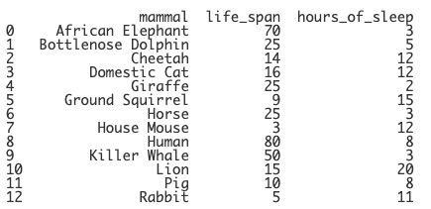
Modifying the Index
print(mammals)
Notes:
Last thing we will talk about in this lesson are the indices. An index is basically an address that is given to each row. But sometimes using the default index doesn’t make much sense. We can change the index used, both temporarily and permanently.

Slide 11
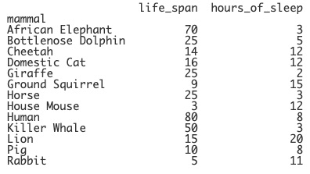
Modifying the Index
print(mammals)
print(mammals.set_index("mammal"))
Notes:
Let’s say we wanted to change the index column from the default to our mammal column. We can use the set_index function to change which column is used as the index. When this is printed, we now see that the mammals column is used. This is just temporary, however. If we printed the mammals DataFrame again, the default indexes are back!

Slide 12
Modifying the Index
print(mammals)
print(mammals.set_index("mammal"))
print(mammals)
Notes:
If we printed the mammals DataFrame again, the default indexes are back!

Slide 13
Modifying the Index
mammals.set_index("mammal", inplace=True)
print(mammals)
Notes:
We can permanently change the index column by adding in the inplace parameter and setting it to True. This will actually modify the DataFrame, so be careful, but now the mammal column will act as the index anytime we print the mammals DataFrame.

Slide 14
Modifying the Index
mammals.reset_index(inplace=True)
print(mammals)
Notes:
We can also reset the index if we’d like and have pandas renumber the rows again. To do this, we use the reset_index function and again, if we want this to be a permanent change, we add in the inplace parameter and set it equal to True. We’ll take a look at how this can be used in the live code example.

Slide 15
Which option would correctly filter a dataframe to display two columns of data?
Notes:
🍐 This is a Pear Deck Multiple Choice Slide. Your current options are: A: print(pets["animal", "age"]), B: print(pets[[animal, age]]), C: print(pets[["animal", "age"]]), D: print(pets[animal, age]),
🍐 To edit the type of question or choices, go back to the "Ask Students a Question" in the Pear Deck sidebar.

Slide 16
Which option would correctly filter a dataframe to display pets who are older than 5?
Notes:
🍐 This is a Pear Deck Multiple Choice Slide. Your current options are: A: print(pets[pets["age"] > 5]), B: print(pets["age"] > 5), C: print(pets[pets["age" > 5]]), D: print([pets["age" > 5]]),
🍐 To edit the type of question or choices, go back to the "Ask Students a Question" in the Pear Deck sidebar.

Slide 17
What parameter should be added to the following function to make the change to the index permanent?
pets.set_index("animal")
Notes:
🍐 This is a Pear Deck Multiple Choice Slide. Your current options are: A: permanent=True, B: permanent=Yes, C: inplace=True, D: inplace=Yes,
🍐 To edit the type of question or choices, go back to the "Ask Students a Question" in the Pear Deck sidebar.

